Slide 1
Research Update
Objective:
To assess whether induced conditions lead to statistically significant changes in the karyotype profile (chromosome copy number across V1–V22) of clones. Each cloneID has a known group assignment and represents a unique observation.
Method: - Permutational Multivariate Analysis of Variance (PERMANOVA)
- GLMM - Mechanistic Modeling

Slide 2
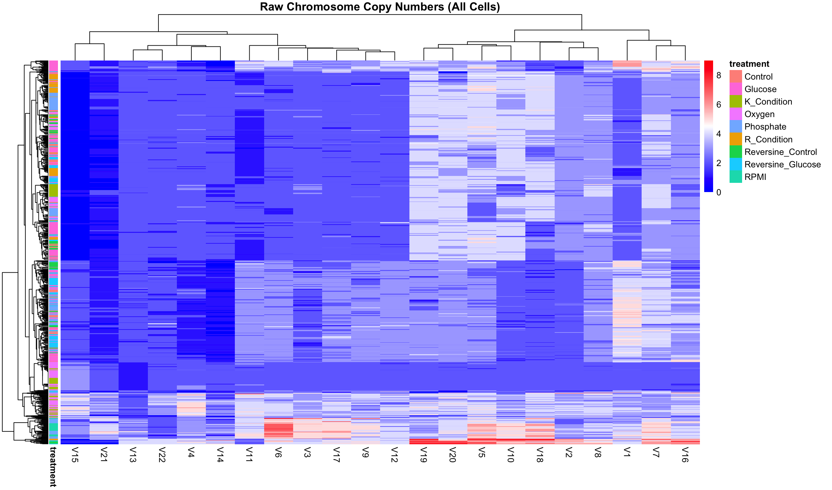
Heatmaps
Note: Cell-Level PERMANOVA without Collapsing Replicates because:
1. I am studying how treatment affects individual cells' karyotypes.
2. Each row represents a unique cell, preserving biological variability within flasks.
3. I stratify by line, so that permutations are done within each cell line.
4. So that I can retain statistical power, because you are using all the data (not just averages).

Slide 3
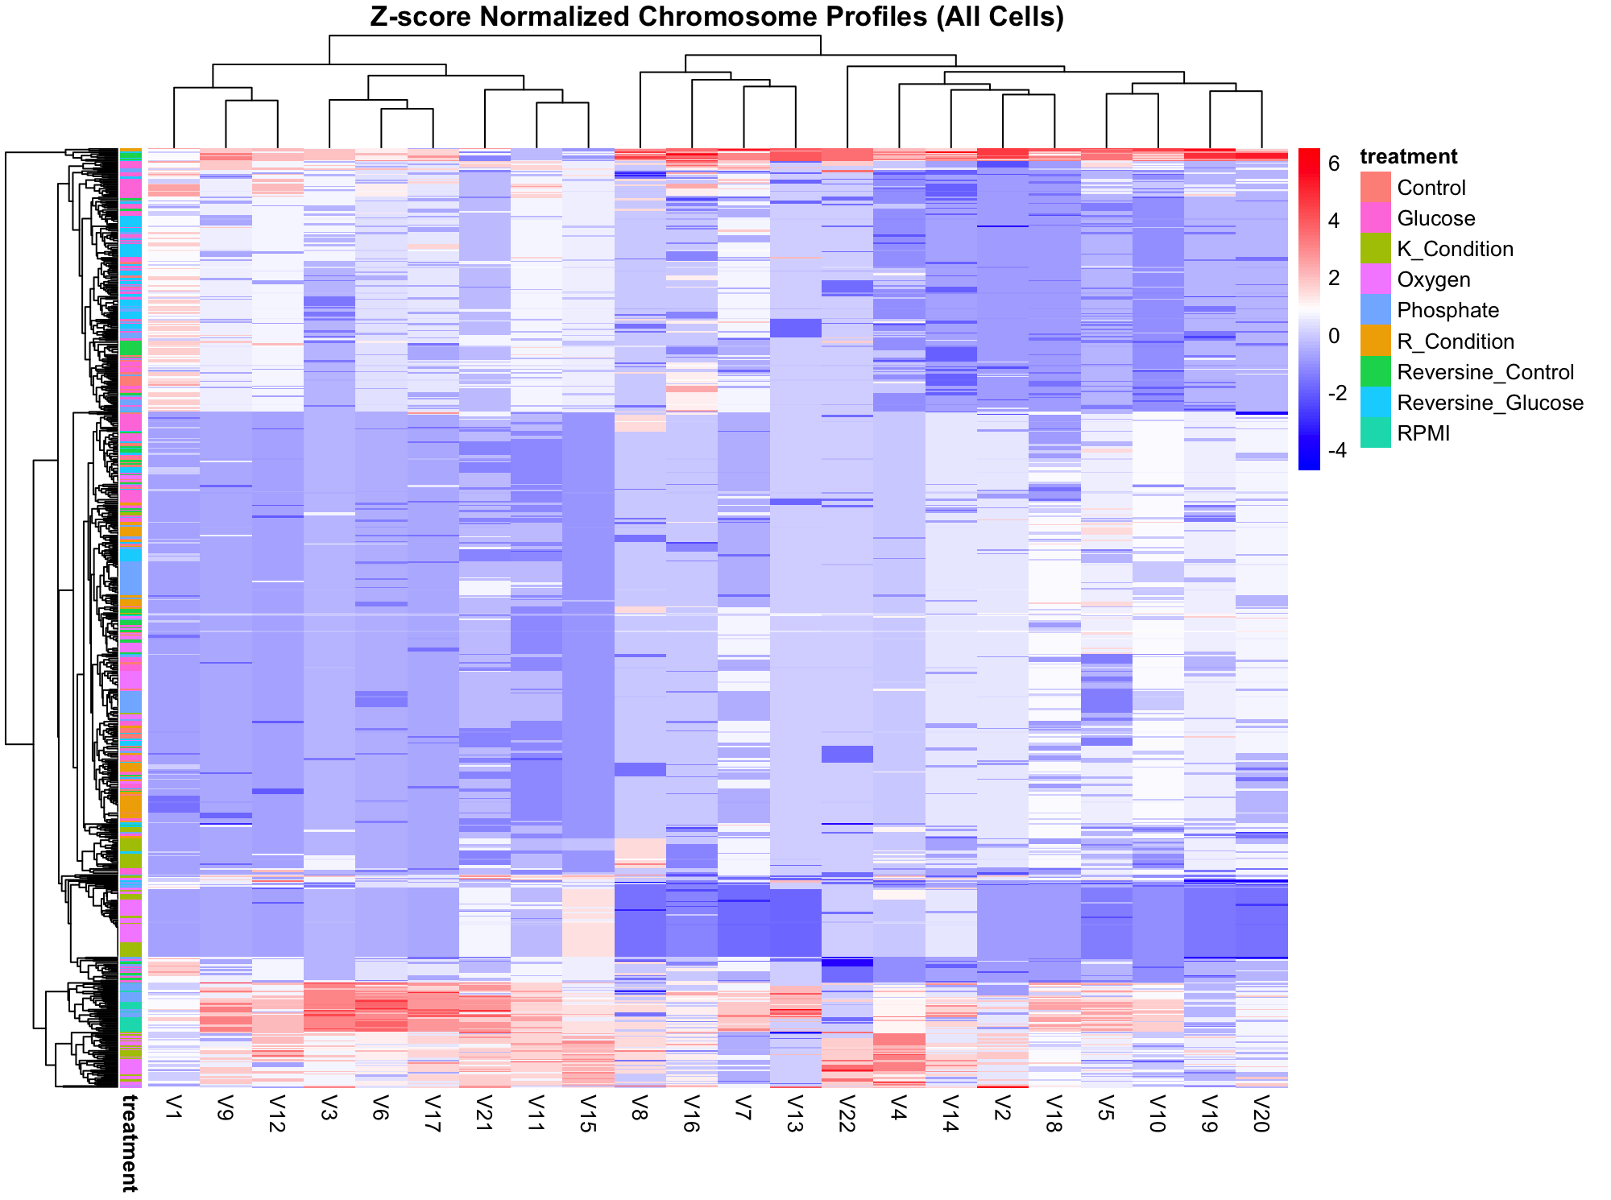
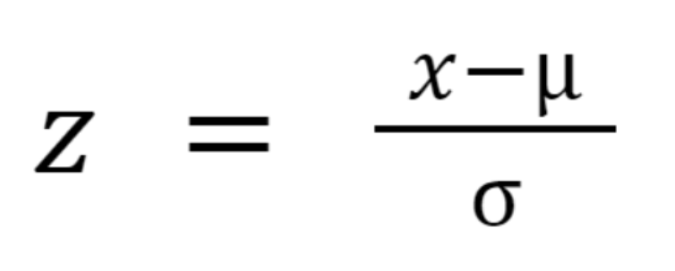
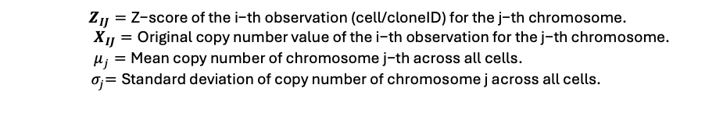
Heatmaps
$$Z_{IJ}=\text{Z}\text{−}\text{score} \text{of} \text{the} \text{i}\text{−}\text{th} \text{observation}\text{ (}\text{cell}\text{/}\text{cloneID}\text{) }\text{for} \text{the} \text{j}\text{−}\text{th} \text{chromosome}\text{.}$$
$X_{IJ}=\text{Original} \text{copy} \text{number} \text{value} \text{of} \text{the} \text{i}\text{−}\text{th} \text{observation} \text{for} \text{the} \text{j}\text{−}\text{th} \text{chromosome}\text{.}$
$μ_{j}=\text{Mean} \text{copy} \text{number} \text{of} \text{chromosome} \text{j}\text{−}\text{th} \text{across} \text{all} \text{cells}\text{.}$
${ σ}_{j}=\text{Standard} \text{deviation} \text{of} \text{copy} \text{number} \text{of} \text{chromosome} \text{j} \text{across} \text{all} \text{cells}$.
Note: Cell-Level PERMANOVA without Collapsing Replicates because:
1. I am studying how treatment affects individual cells' karyotypes.
2. Each row represents a unique cell, preserving biological variability within flasks.
3. I stratify by line, so that permutations are done within each cell line.
4. So that I can retain statistical power, because you are using all the data (not just averages).

Slide 4
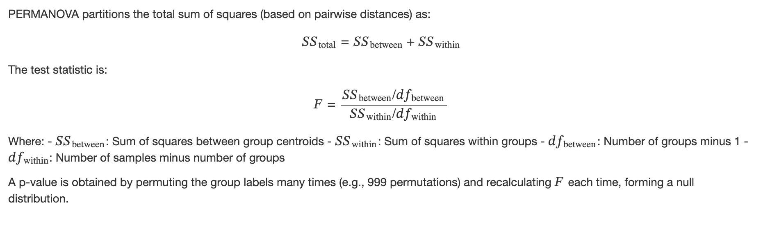
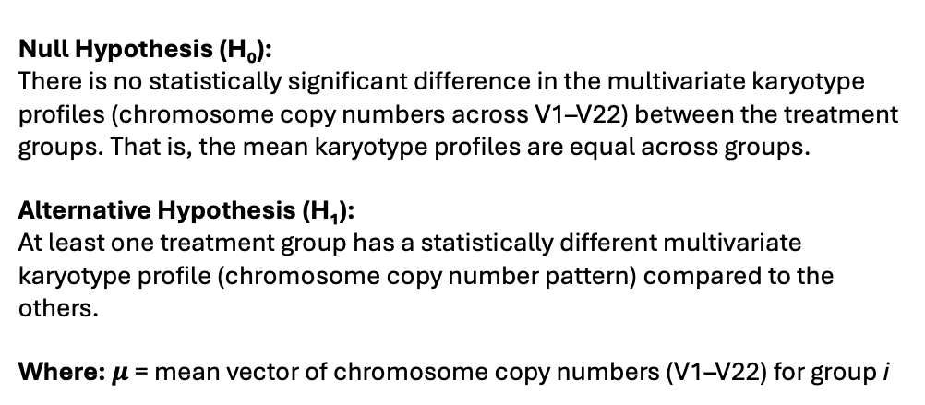
Null Hypothesis (H₀): There is no statistically significant difference in the multivariate karyotype profiles (chromosome copy numbers across V1–V22) between the treatment groups. That is, the mean karyotype profiles are equal across groups. Alternative Hypothesis (H₁): At least one treatment group has a statistically different multivariate karyotype profile (chromosome copy number pattern) compared to the others.
Where: $μ$ = mean vector of chromosome copy numbers (V1–V22) for group i
What is PERMANOVA: PERMANOVA tests whether the centroids of groups in multivariate space (e.g., based on chromosome copy number profiles) are significantly different, using distance matrices and permutation testing rather than distributional assumptions.

Slide 5
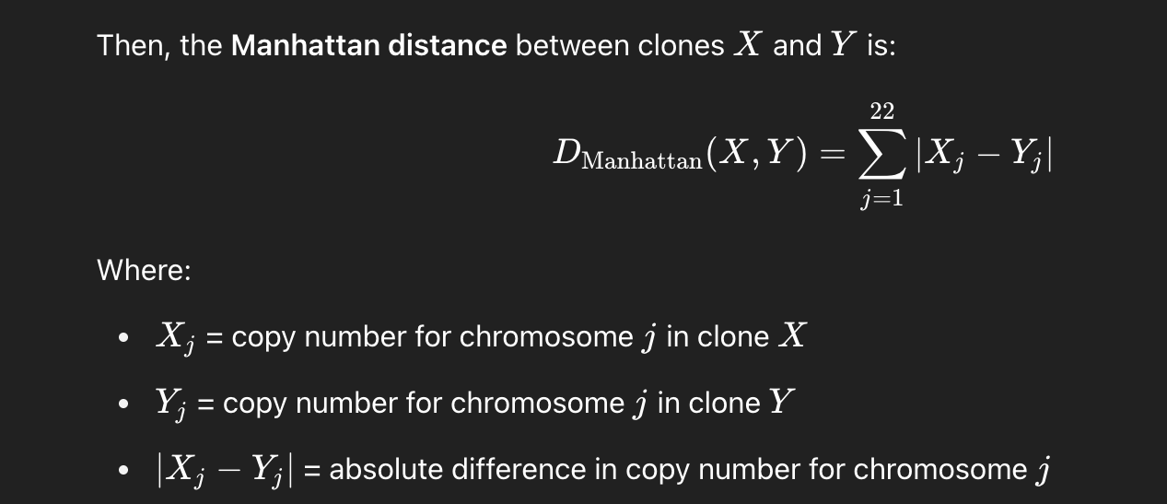
Null Hypothesis (H₀): There is no statistically significant difference in the multivariate karyotype profiles (chromosome copy numbers across V1–V22) between the treatment groups. That is, the mean karyotype profiles are equal across groups. Alternative Hypothesis (H₁): At least one treatment group has a statistically different multivariate karyotype profile (chromosome copy number pattern) compared to the others.
Where: $μ$ = mean vector of chromosome copy numbers (V1–V22) for group i
What is PERMANOVA: PERMANOVA tests whether the centroids of groups in multivariate space (e.g., based on chromosome copy number profiles) are significantly different, using distance matrices and permutation testing rather than distributional assumptions.
The Manhattan distance sums up the absolute differences in chromosome copy numbers (V1–V22) between two clones. It measures how much their karyotype profiles differ overall, treating each chromosome equally.

Slide 6
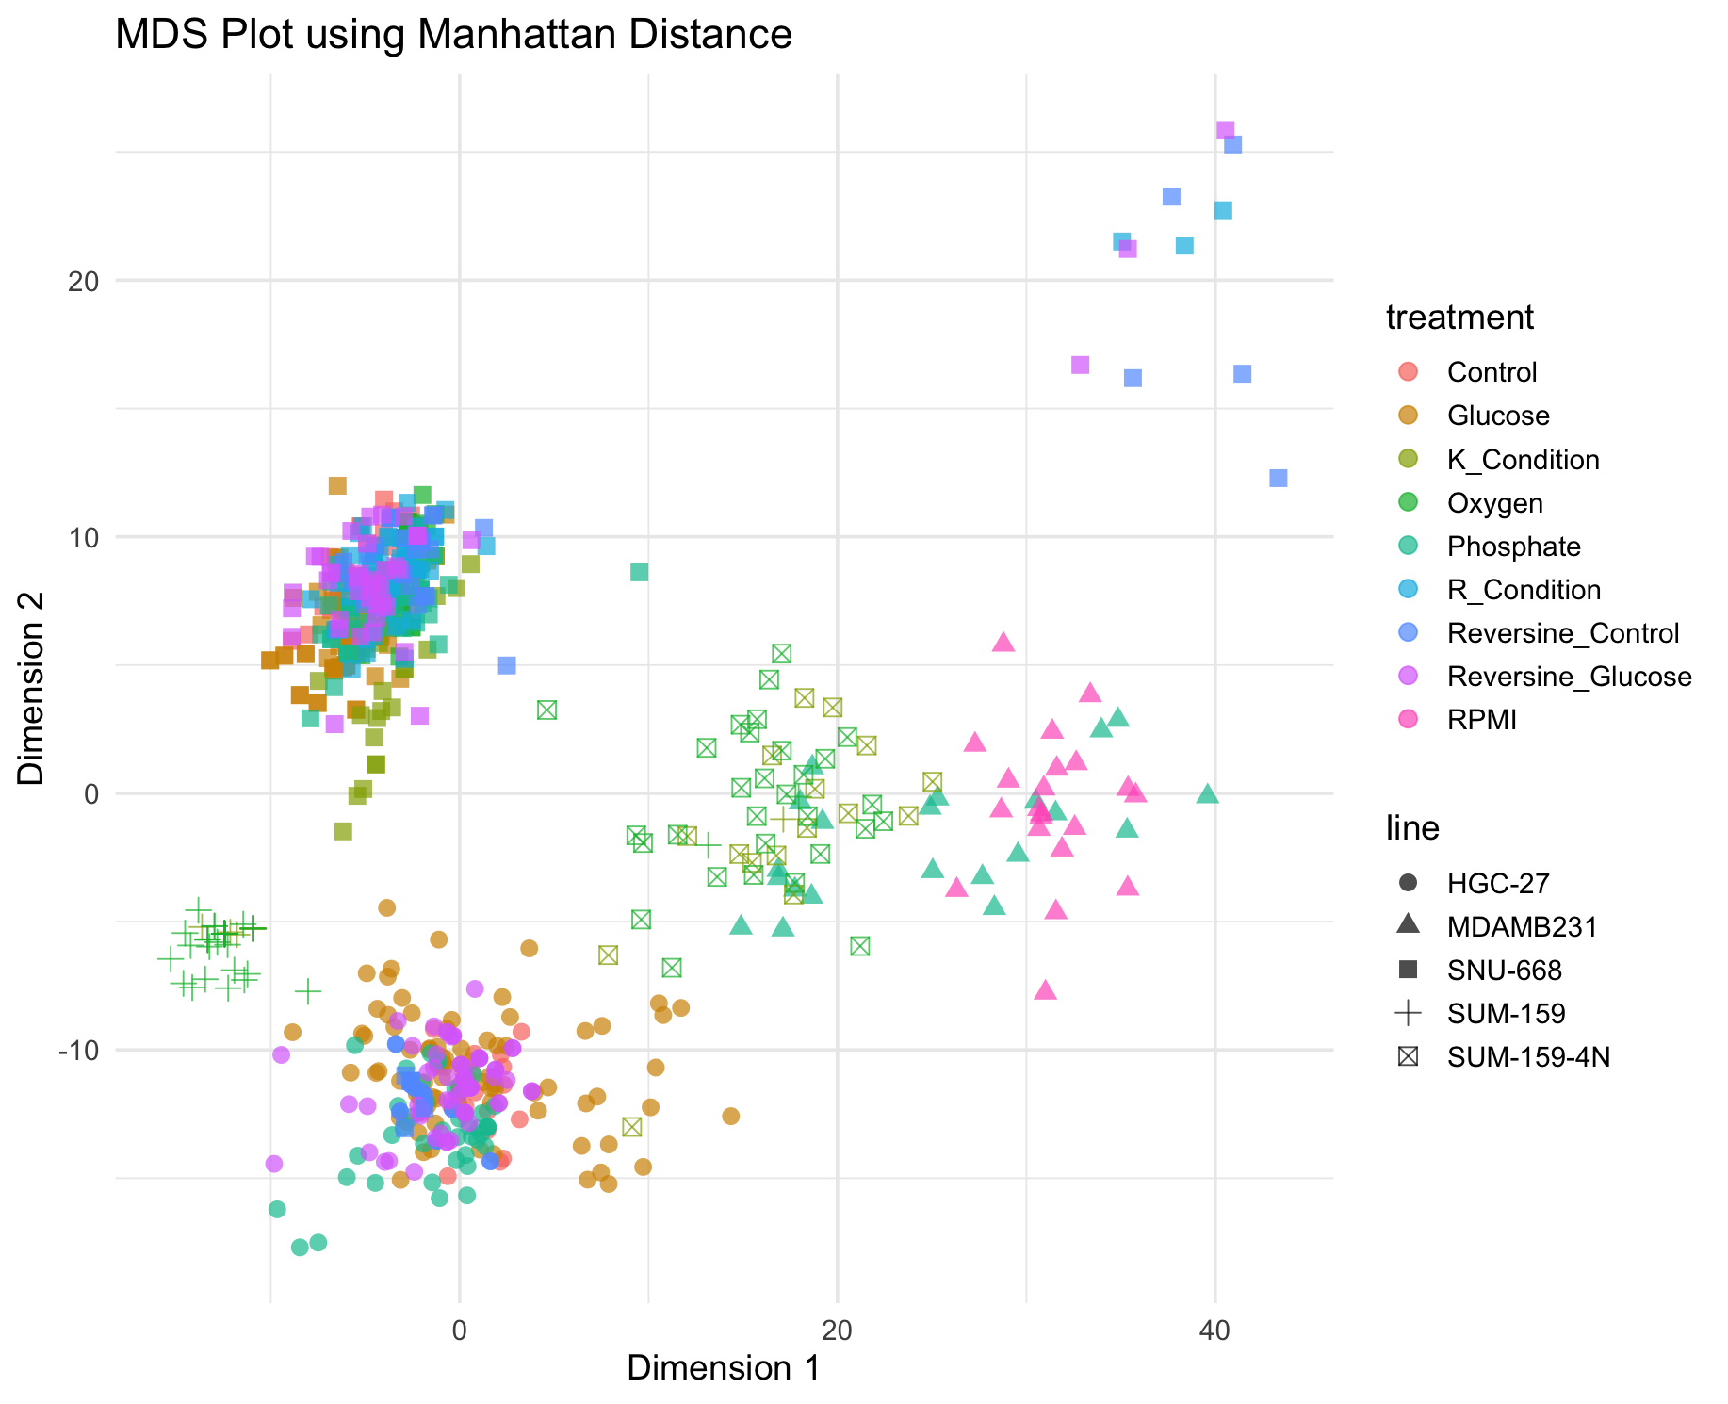

Slide 7
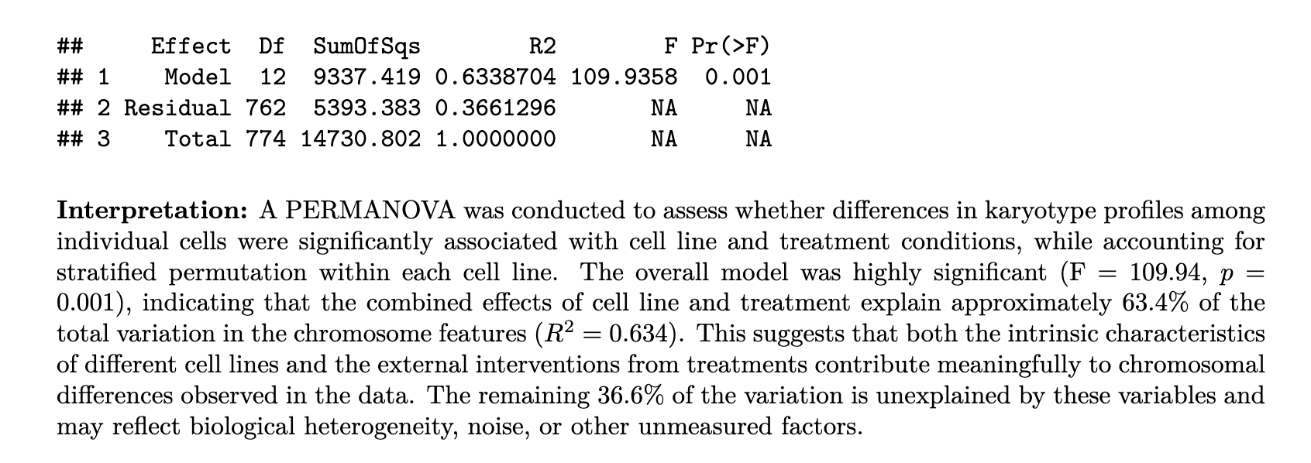
Null Hypothesis (H₀): There is no statistically significant difference in the multivariate karyotype profiles (chromosome copy numbers across V1–V22) between the condition groups. That is, the mean karyotype profiles are equal across groups. Alternative Hypothesis (H₁): At least one condition groups has a statistically different multivariate karyotype profile (chromosome copy number pattern) compared to the others.

Slide 8
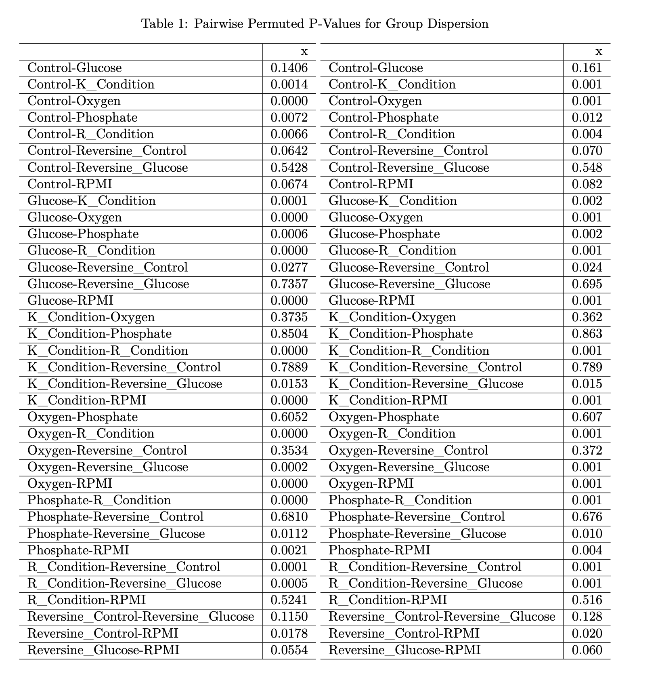
Post-Hoc:

Slide 9
Post-Hoc:
The pairwise PERMDISP analysis revealed significant differences in dispersion (i.e.,within-group variability) among several treatment groups, indicating that the assumption of homogenous variance required by PERMANOVA is violated in many comparisons. Notably, treatments such as Glucose, Oxygen, R_Condition, and Reversine_Glucose showed significant differences in dispersion when compared with multiple other treatments (p < 0.05). For example, Glucose differed significantly from K_Condition, Phosphate, and R_Condition, while R_Condition differed in dispersion from nearly all other treatments, suggesting it may be especially destabilizing to karyotypic structure. In contrast, treatments like Control vs Reversine_Glucose and Reversine_Control vs Reversine_Glucose did not differ significantly in their dispersion, indicating comparable within-group variability. These findings imply that differences observed in PERMANOVA results could, at least in part, be driven by differences in dispersion rather than shifts in
group centroids alone.

Slide 10
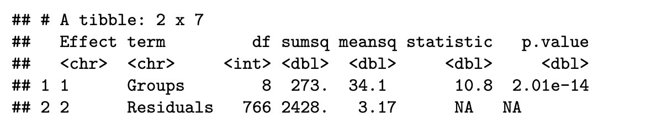
PERMDISP:
Are the multivariate dispersions (variances) across groups significantly different? In PERMANOVA, we check PERMDISP to validate that our significant PERMANOVA result is due to differences in group means (centroids) rather than differences in group variability (dispersion).

Slide 11
PERMDISP:
Are the multivariate dispersions (variances) across groups significantly different? In PERMANOVA, we check PERMDISP to validate that our significant PERMANOVA result is due to differences in group means (centroids) rather than differences in group variability (dispersion).
Interpretation: The analysis of multivariate dispersions (PERMDISP) revealed a significant difference in dispersion among treatment groups (F = 10.76, p < 0.001), suggesting that variability within treatments is not uniform. This violates a key assumption of PERMANOVA, which presumes homogeneous dispersions.
Consequently, although significant PERMANOVA results may indicate group differences, part of this difference could stem from heterogeneous group variances (dispersion), rather than true differences in centroid locations.

Slide 12
